Slide 1
ESRGAN: Enhanced Super-Resolution Generative Adversarial Networks
Xintao Wang , Ke Yu , Shixiang Wu , Jinjin Gu , Yihao Liu , Chao Dong , Chen Change Loy , Yu Qiao , Xiaoou Tang

Slide 2
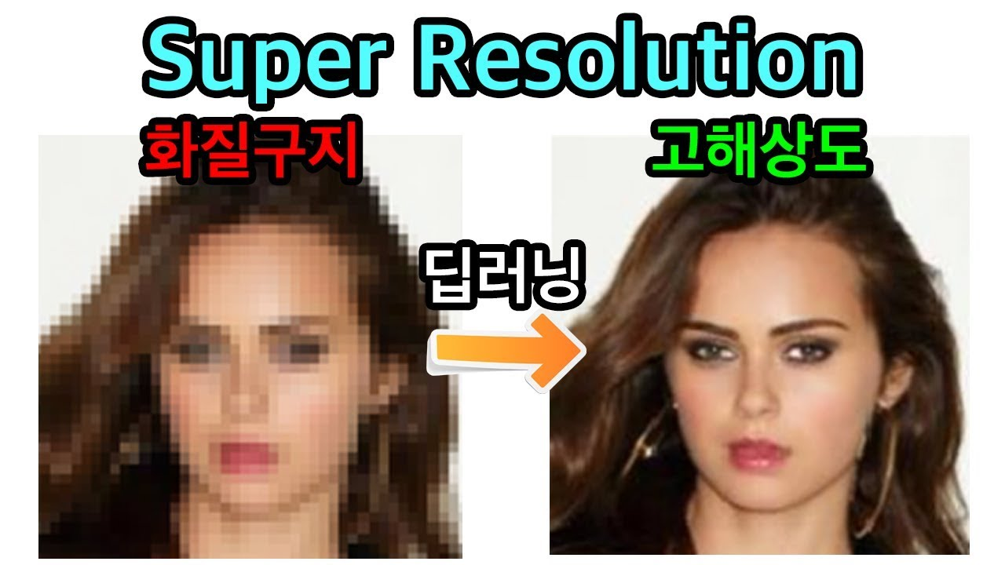
What is Super Resolution ?

Slide 3
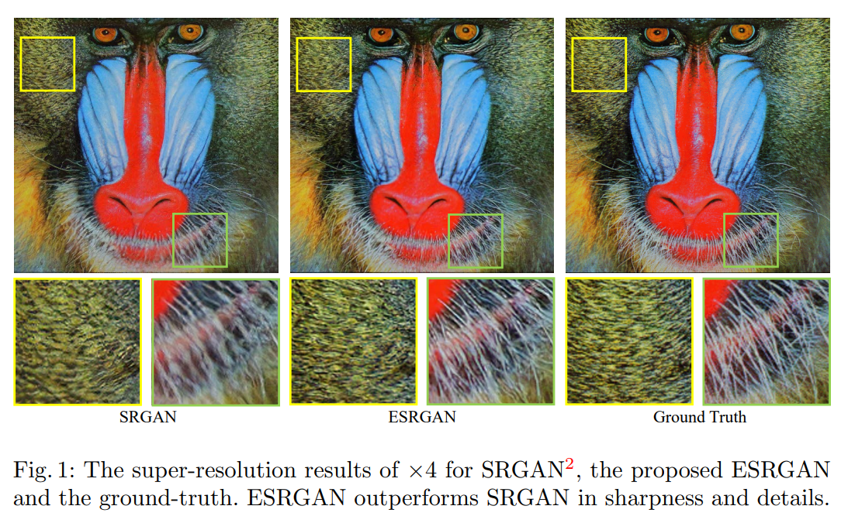
What is ESRGAN ?

Slide 4
Introduction
Residual-in-Residual Dense Block (RRDB) without batch normalization is introduced.
Idea from relativistic GAN is used to let the discriminator predict relative realness instead of the absolute value.
The perceptual loss of using the features before activation is used, which provides stronger supervision for brightness consistency and texture recovery.
ESRGAN won the First Place in PIRM2018-SR challenge
Notes:
Residual-in-Residual Dense Block (RDDB)를 도입하고 Batch Normalization을 제거하며 residual scaling을 사용합니다.
Relativistic average GAN (RaGAN)을 사용하여 Discriminator의 구조를 형성합니다. RaGAN에서는 Discriminatort가 '이미지가 진짜인지 가짜인지' 판단하지 않고 '하나의 이미지가 다른 이미지보다 더 현실적인가 아닌가'를 판단합니다.
activation function을 거치기전의 최종 VGG feature를 사용하여 perceptual loss를 계산합니다. 기존 SRGAN에서는 activation function까지 거친 VGG feature에 perceptual loss를 계산합니다.

Slide 5
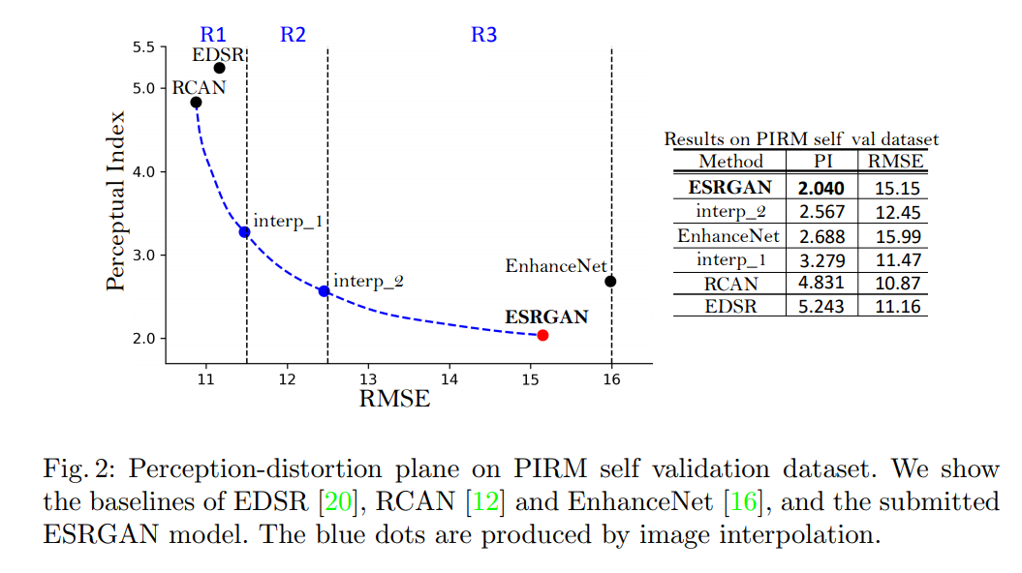
Perceptual Quality and Objective Quality
RMSE is a measure of objective quality. Higher RMSE, lower objective quality. It is measured in an objective way.
Perceptual Index (PI) is a measure of perceptual quality. Higher PI, lower perceptual quality. Perceptual quality is a quality which is much close to human eyes.
ESRGAN intends to improve perceptual quality rather than objective quality, such as PSNR.

Slide 6
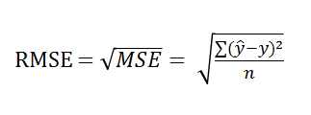
RMSE(Root Mean Square Error)
​잔차 제곱의 평균 제곱근

Slide 7
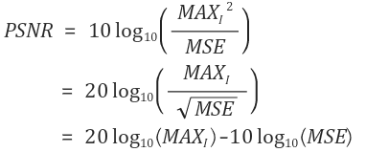
PSNR(Peak Signal to Noise Ratio, 최대 신호 대 잡음비율)
사람 관측의 관점에서 주관적인 평가에 허용이 되지 않기에, 고주파 부분들을 무시하고 over-smoothed 한 결과를 내보내는 경향이 있다고 한다. 이는 즉, 사람이 느끼는 부분과 일치하지 않은 점수를 산출하는 것이 원인

Slide 8
Network Architecture

Slide 9
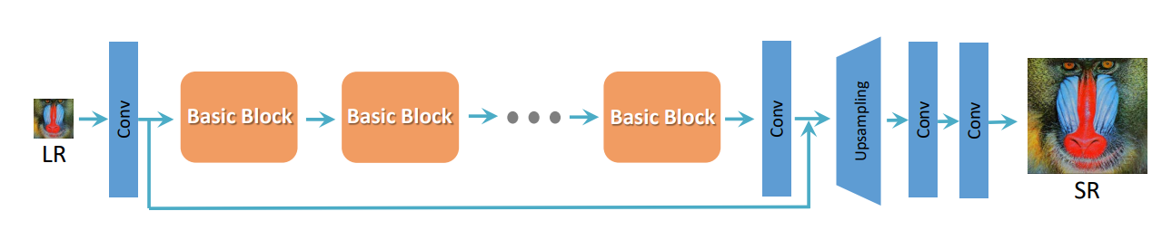
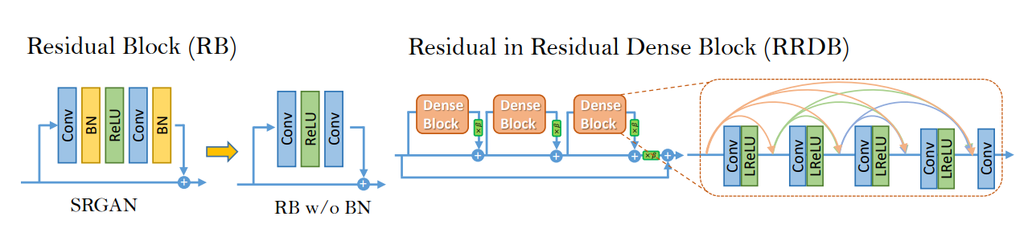
Residual-in-Residual Dense Block (RRDB)
The basic architecture of SRResNet/SRGAN
RRDB is used as Basic Block in ESRGAN

Slide 10
Residual-in-Residual Dense Block (RRDB)
1) Batch Normalization (BN) is removed.
-> Removing BN layers has proven to increase performance and reduce the computational complexity in different PSNR-oriented tasks, including SR.
2) The Dense Block, originated in DenseNet, is used to replace the residual block to enhance the network.

Slide 11
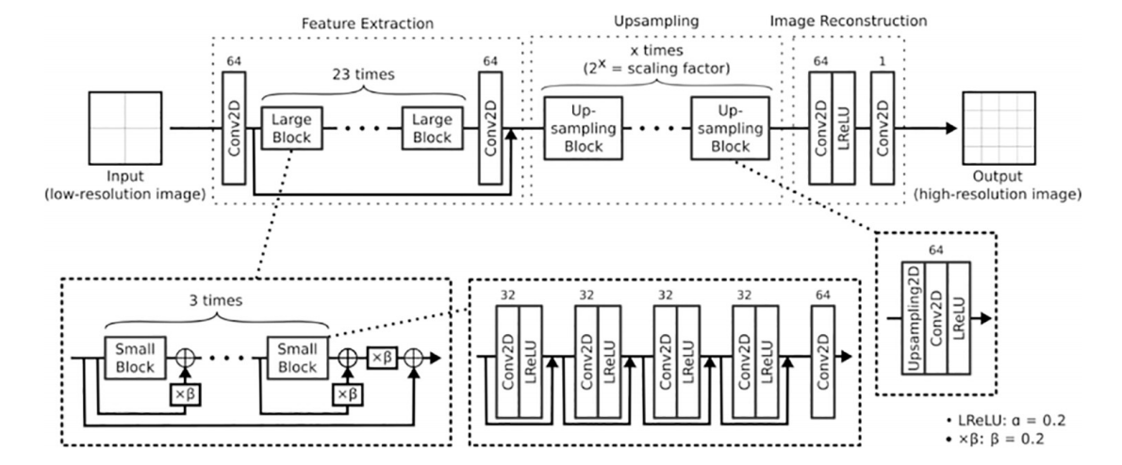
Residual-in-Residual Dense Block (RRDB)

Slide 12
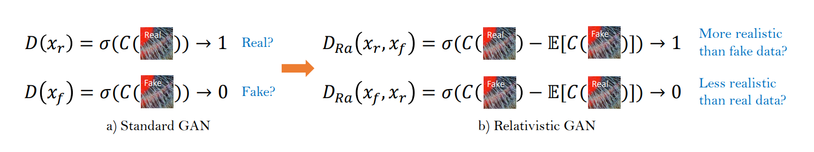
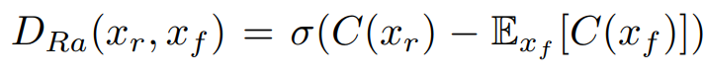
Relativistic GAN
E is the operation of taking the average for all fake data in the mini-batch.
a relativistic discriminator tries to predict the probability that a real image XR is relatively more realistic than a fake one xf.

Slide 13
Relativistic GAN
discriminator loss
The adversarial loss for the generator is in a symmetrical form
It is observed that the adversarial loss for the generator contains both XR and xf. Therefore, the generator benefits from the gradients from both generated data and real data in adversarial training

Slide 14
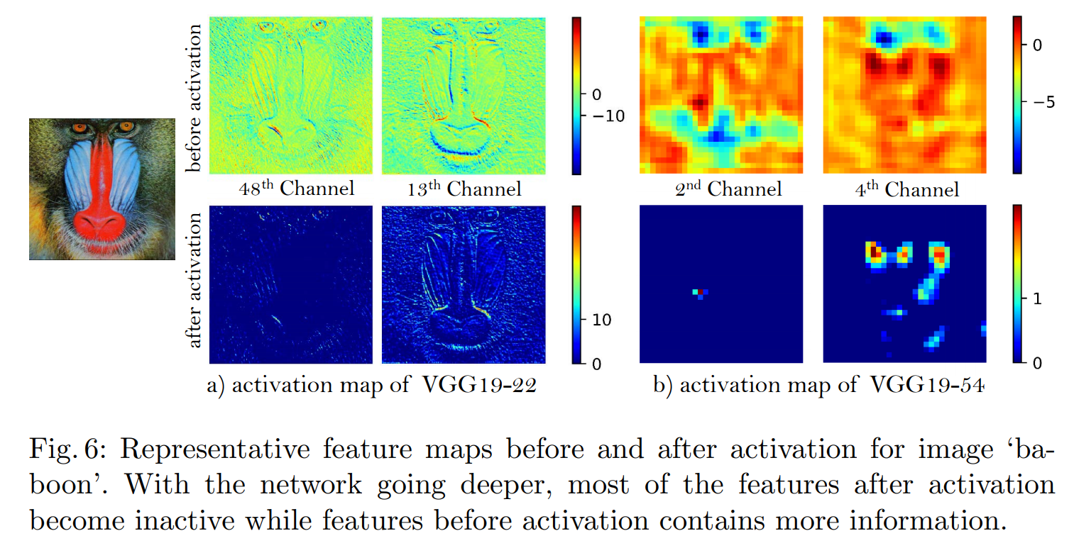
Perceptual Loss
In ESRGAN, the features before the activation layers are used.
If features after activation layers are used, there would be drawbacks:
the activated features are very sparse

Slide 15
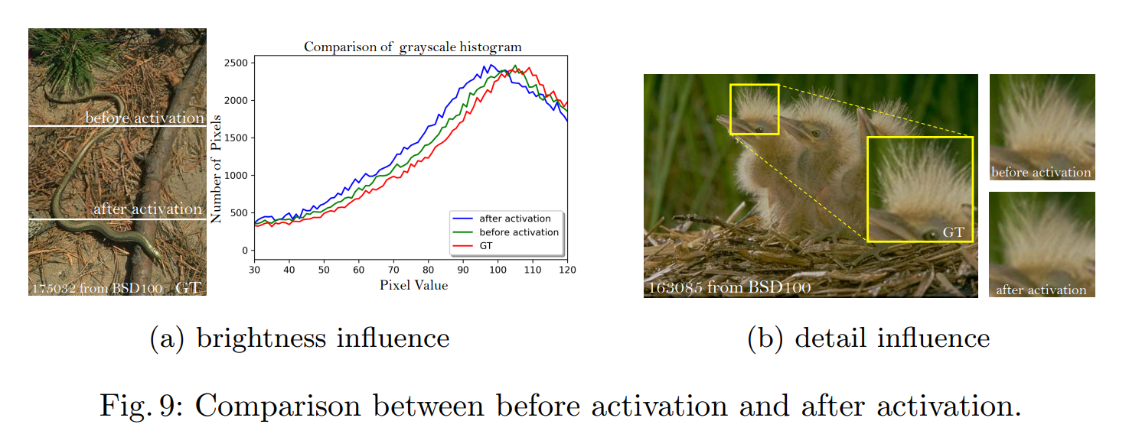
Perceptual Loss
If features after activation layers are used, there would be drawbacks:
using features after activation also causes inconsistent reconstructed brightness compared with the ground-truth image.

Slide 16
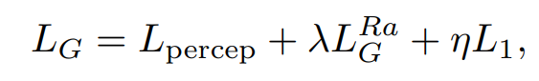
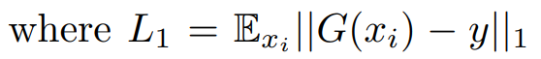
Total loss
Lpercep is the VGG loss, LGRA is the adversarial loss, and L1 is the standard L1 loss, which is act as a content loss.

Slide 17
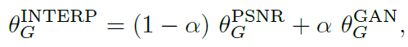
network Interpolation
First, we train a PSNR-oriented network GPSNR, and then we obtain a GAN-based network GGAN by fine-tuning
All the corresponding parameters of these two networks are interpolated to derive an interpolated model GINTERP:
where α is between 0 to 1. There are two merits:
First, the interpolated model is able to produce meaningful results for any feasible without introducing artifacts.
Second, we can continuously balance perceptual quality and fidelity without re-training the model.

Slide 18
Data
Training Data: DIV2K that contains 800 images, Flickr2K dataset that consisting of 2650 2K high-resolution images, and OutdoorSceneTraining (OST) dataset are used.
Models are trained in RGB channels, and the training dataset is augmented with random horizontal flips and 90-degree rotations.

Slide 19
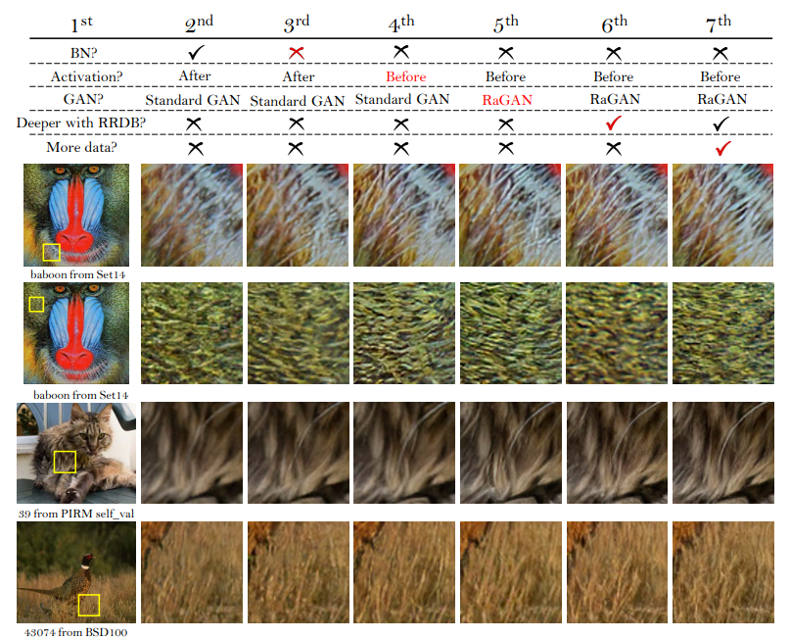
Ablation Experiments

Slide 20
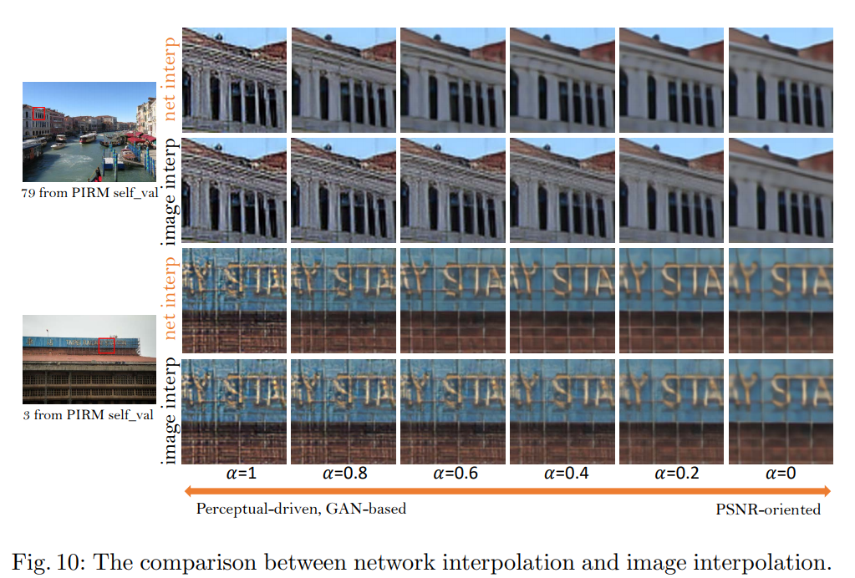
Network Interpolation
sharp edges and richer textures but with some unpleasant artifacts
cartoon-style blurry images.

Slide 21
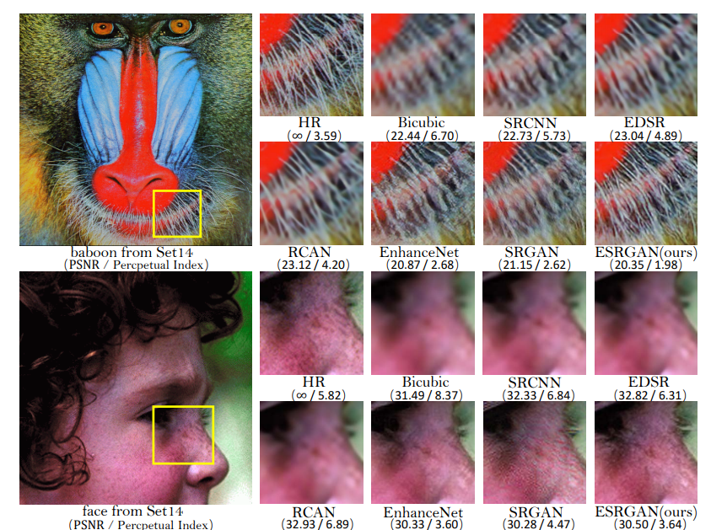
Benchmark Dataset

Slide 22
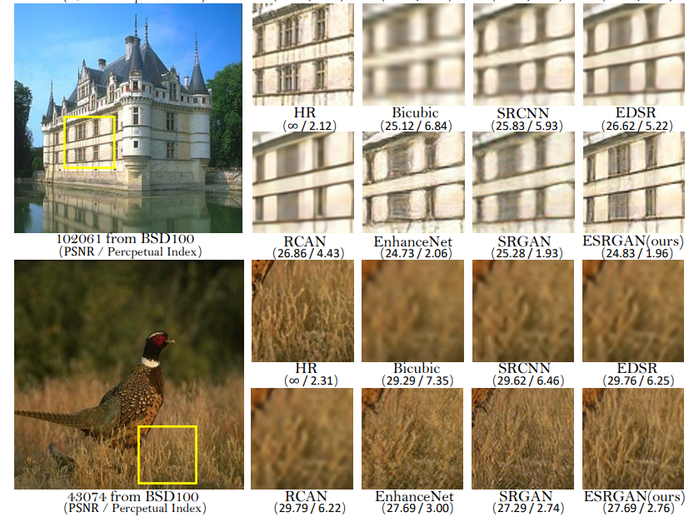
Benchmark Dataset

Slide 23
감사합니다.

